Slide 1

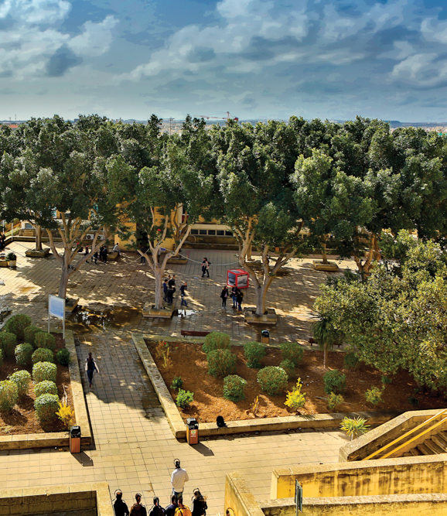








Erasmus+ Digital Education and Timely Solutions Project (DIG-IT) 2019-2022

Slide 2

Purpose
The purpose of the Erasmus+ DIG-IT project is to provide solutions that address the production and delivery of digital education in the EU higher education system.
Notes:
Some visionaries have criticized traditional education institutions as out dated in their views and practices
Drucker (1997) suggested that the antiquated processes of admissions, registration, and fixed class meeting places and times all indicate that institutions are not responding to the needs of their clients, nor are they taking advantage of universally available access to communication technologies
Denial - Many educators are not taking advantage of the technologies currently available MacDonald et al. (2005) coined the phrase “the eLearning Contradiction” to describe the incongruity between the expressed need to integrate technology into teaching and what is currently occurring in the majority of universities
Bargaining the benefits and limitations of online learning are well documented in the literature (MacDonald & Gabriel, 1998; MacDonald, Stodel, Farres, Breithaupt, & Gabriel, 2001)
Supporters of eLearning promote its convenience and flexibility and argue that well designed eLearning can be equal to or superior to face-to-face courses
They encourage critics to open themselves to new ways of organizing activities and instruction
Such critics suggest that online learning may be a “poor substitute for classroom teaching” (Beckett).
Others identify a misfit of technological rhetoric within the realities of educational settings.
Furthermore, questions have been raised regarding the pedagogical quality that technology provides (Duderstadt, 1999; Fox & Herrmann, 2000).
Anger - Still more have complained about a lack of professional development and support for educators to learn and gain confidence with these educational technologies.
Further, professors may feel that their time is better spent securing research grants and publishing
Professors need support in the way of training, time and recognition for their eLearning efforts
Higher education has been shaped by debate among academics, industry experts, students, and politicians
It is undeniable that, in recent years, budget restrictions and changing student enrolments have forced educators to become
more efficient
Advocates asserted that effective instruction must be driven by sound pedagogical principals, involve critical thinking, and provide a real community to learners
Although everyone wants quality courses, stakeholders bring different definitions of quality, which impacts the planning process, Benson (2003)
MacDonald et al. (2005) suggested why professors may prefer to stay with their tried and true methods of teaching
Little incentive for professors to devote the hours required to design technology-based resources
Further, professors may feel that their time is better spent securing research grants and publishing. (p. 80)
Educators may hesitate to turn to eLearning is because they believe that online learning isolates the learner and lacks interactivity
Along with Lave and Wenger (1991), many would agree that learning is fundamentally a socially situated process that is enhanced when there is a commitment to the collective good and people engage in learning through and with others
The online environment is not necessarily devoid of such social interactions and research has revealed it is possible to create a community online.

Slide 3
Intellectual Output 1
European Union Digital Education Quality Standard Framework and Companion Evaluation Framework
Notes:
Some visionaries have criticized traditional education institutions as out dated in their views and practices
Drucker (1997) suggested that the antiquated processes of admissions, registration, and fixed class meeting places and times all indicate that institutions are not responding to the needs of their clients, nor are they taking advantage of universally available access to communication technologies
Denial - Many educators are not taking advantage of the technologies currently available MacDonald et al. (2005) coined the phrase “the eLearning Contradiction” to describe the incongruity between the expressed need to integrate technology into teaching and what is currently occurring in the majority of universities
Bargaining the benefits and limitations of online learning are well documented in the literature (MacDonald & Gabriel, 1998; MacDonald, Stodel, Farres, Breithaupt, & Gabriel, 2001)
Supporters of eLearning promote its convenience and flexibility and argue that well designed eLearning can be equal to or superior to face-to-face courses
They encourage critics to open themselves to new ways of organizing activities and instruction
Such critics suggest that online learning may be a “poor substitute for classroom teaching” (Beckett).
Others identify a misfit of technological rhetoric within the realities of educational settings.
Furthermore, questions have been raised regarding the pedagogical quality that technology provides (Duderstadt, 1999; Fox & Herrmann, 2000).
Anger - Still more have complained about a lack of professional development and support for educators to learn and gain confidence with these educational technologies.
Further, professors may feel that their time is better spent securing research grants and publishing
Professors need support in the way of training, time and recognition for their eLearning efforts
Higher education has been shaped by debate among academics, industry experts, students, and politicians
It is undeniable that, in recent years, budget restrictions and changing student enrolments have forced educators to become
more efficient
Advocates asserted that effective instruction must be driven by sound pedagogical principals, involve critical thinking, and provide a real community to learners
Although everyone wants quality courses, stakeholders bring different definitions of quality, which impacts the planning process, Benson (2003)
MacDonald et al. (2005) suggested why professors may prefer to stay with their tried and true methods of teaching
Little incentive for professors to devote the hours required to design technology-based resources
Further, professors may feel that their time is better spent securing research grants and publishing. (p. 80)
Educators may hesitate to turn to eLearning is because they believe that online learning isolates the learner and lacks interactivity
Along with Lave and Wenger (1991), many would agree that learning is fundamentally a socially situated process that is enhanced when there is a commitment to the collective good and people engage in learning through and with others
The online environment is not necessarily devoid of such social interactions and research has revealed it is possible to create a community online.

Slide 4
Rationale
Need for Quality Standards for DE
Quality online design is the cornerstone of effective eLearning
Determining an appropriate theoretical framework was a logical first step to developing quality standards.
A curriculum framework acts as a credible, quality standard and guide for designing, delivering and evaluating effective education programs resulting in superior digital education experiences.
Notes:
Some visionaries have criticized traditional education institutions as out dated in their views and practices
Drucker (1997) suggested that the antiquated processes of admissions, registration, and fixed class meeting places and times all indicate that institutions are not responding to the needs of their clients, nor are they taking advantage of universally available access to communication technologies
Denial - Many educators are not taking advantage of the technologies currently available MacDonald et al. (2005) coined the phrase “the eLearning Contradiction” to describe the incongruity between the expressed need to integrate technology into teaching and what is currently occurring in the majority of universities
Bargaining the benefits and limitations of online learning are well documented in the literature (MacDonald & Gabriel, 1998; MacDonald, Stodel, Farres, Breithaupt, & Gabriel, 2001)
Supporters of eLearning promote its convenience and flexibility and argue that well designed eLearning can be equal to or superior to face-to-face courses
They encourage critics to open themselves to new ways of organizing activities and instruction
Such critics suggest that online learning may be a “poor substitute for classroom teaching” (Beckett).
Others identify a misfit of technological rhetoric within the realities of educational settings.
Furthermore, questions have been raised regarding the pedagogical quality that technology provides (Duderstadt, 1999; Fox & Herrmann, 2000).
Anger - Still more have complained about a lack of professional development and support for educators to learn and gain confidence with these educational technologies.
Further, professors may feel that their time is better spent securing research grants and publishing
Professors need support in the way of training, time and recognition for their eLearning efforts
Higher education has been shaped by debate among academics, industry experts, students, and politicians
It is undeniable that, in recent years, budget restrictions and changing student enrolments have forced educators to become
more efficient
Advocates asserted that effective instruction must be driven by sound pedagogical principals, involve critical thinking, and provide a real community to learners
Although everyone wants quality courses, stakeholders bring different definitions of quality, which impacts the planning process, Benson (2003)
MacDonald et al. (2005) suggested why professors may prefer to stay with their tried and true methods of teaching
Little incentive for professors to devote the hours required to design technology-based resources
Further, professors may feel that their time is better spent securing research grants and publishing. (p. 80)
Educators may hesitate to turn to eLearning is because they believe that online learning isolates the learner and lacks interactivity
Along with Lave and Wenger (1991), many would agree that learning is fundamentally a socially situated process that is enhanced when there is a commitment to the collective good and people engage in learning through and with others
The online environment is not necessarily devoid of such social interactions and research has revealed it is possible to create a community online.

Slide 5


Four Step Process
Step 1: Review of Literature
Step 2: Operationalizing the Key Elements of Online Learning
Step 3: Creating the Erasmus+ EU Framework Diagram and Digital Tool
Step 4: Companion Evaluation Tools

Slide 6

Step 1 – Review of Literature
First step was to take advantage of previous work and research on DE frameworks and models.
Digital educational solutions have been used for over two decades across disciplines, so several models and frameworks exist.
Could an existing framework be adopted.
What are their strengths and shortcomings?
Can relevant concepts from existing frameworks coupled with experiential knowledge and evidence-based practices be combined to create a new framework that extends existing knowledge and would be applicable for effective DE in 2020 and beyond?

Slide 7

Methodology
Torraco’s (2016) guidelines were performed to detect available models and frameworks for eLearning in higher education.
4 Research platforms: Eric, PubMed, Cinahl and Scopus.
Search terms: framework, model, eLearning, digital und web-based learning and higher education.
English, the last 20 years, either a framework or model on eLearning in the higher education setting.
Reference lists of omitted articles were screened to identify potential additional relevant articles.

Slide 8

Results
Electronic search identified 6,207 potentially relevant articles
112 articles remained for full-text assessment after the title and abstract screening.
A total of 32 articles were deemed eligible.
Five other relevant publications were identified through the reference lists search
Therefore, a total of 37 studies were included in the final review.
Notes:
Denial - Many educators are not taking advantage of the technologies currently available MacDonald et al. (2005) coined the phrase “the eLearning Contradiction” to describe the incongruity between the expressed need to integrate technology into teaching and what is currently occurring in the majority of universities. University students complained that no one answered the phone when they called, registration was complicated and parking impossible.
Bargaining The benefits and limitations of online learning are well documented in the literature (MacDonald & Gabriel, 1998; MacDonald, Stodel, Farres, Breithaupt, & Gabriel, 2001)
Supporters of eLearning promote its convenience and flexibility and argue that well designed eLearning can be equal to or superior to face-to-face courses
They encourage critics to open themselves to new ways of organizing activities and instruction
Such critics suggest that online learning may be a “poor substitute for classroom teaching” (Beckett).
Others identify a misfit of technological rhetoric within the realities of educational settings.
Furthermore, questions have been raised regarding the pedagogical quality that technology provides (Duderstadt, 1999; Fox & Herrmann, 2000).
Anger - Still more have complained about a lack of professional development and support for educators to learn and gain confidence with these educational technologies.
Further, professors may feel that their time is better spent securing research grants and publishing
Professors need support in the way of training, time and recognition for their eLearning efforts
Higher education has been shaped by debate among academics, industry experts, students, and politicians
It is undeniable that, in recent years, budget restrictions and changing student enrolments have forced educators to become
more efficient
Advocates asserted that effective instruction must be driven by sound pedagogical principals, involve critical thinking, and provide a real community to learners
Although everyone wants quality courses, stakeholders bring different definitions of quality, which impacts the planning process, Benson (2003)
MacDonald et al. (2005) suggested why professors may prefer to stay with their tried and true methods of teaching
Little incentive for professors to devote the hours required to design technology-based resources
Further, professors may feel that their time is better spent securing research grants and publishing. (p. 80)
Educators may hesitate to turn to eLearning is because they believe that online learning isolates the learner and lacks interactivity
Along with Lave and Wenger (1991), many would agree that learning is fundamentally a socially situated process that is enhanced when there is a commitment to the collective good and people engage in learning through and with others
The online environment is not necessarily devoid of such social interactions and research has revealed it is possible to create a community online.

Slide 9
Study Selection, Data Extraction
Results imported and merged into the Mendeley Web Reference Management software
Four reviewers independently screened the search results by title and abstract.
Extracted the following information from the studies: first author, year, name of model/framework, target audience, model description, model variables, strengths, and areas for development.
Relevant information from retrieved articles was extracted for a narrative synthesis by all reviewers and disagreements resolved by discussion and consensus.
Reference lists of all the included papers were searched to identify articles that may have been missed in the electronic searches.
Notes:
Denial - Many educators are not taking advantage of the technologies currently available MacDonald et al. (2005) coined the phrase “the eLearning Contradiction” to describe the incongruity between the expressed need to integrate technology into teaching and what is currently occurring in the majority of universities. University students complained that no one answered the phone when they called, registration was complicated and parking impossible.
Bargaining The benefits and limitations of online learning are well documented in the literature (MacDonald & Gabriel, 1998; MacDonald, Stodel, Farres, Breithaupt, & Gabriel, 2001)
Supporters of eLearning promote its convenience and flexibility and argue that well designed eLearning can be equal to or superior to face-to-face courses
They encourage critics to open themselves to new ways of organizing activities and instruction
Such critics suggest that online learning may be a “poor substitute for classroom teaching” (Beckett).
Others identify a misfit of technological rhetoric within the realities of educational settings.
Furthermore, questions have been raised regarding the pedagogical quality that technology provides (Duderstadt, 1999; Fox & Herrmann, 2000).
Anger - Still more have complained about a lack of professional development and support for educators to learn and gain confidence with these educational technologies.
Further, professors may feel that their time is better spent securing research grants and publishing
Professors need support in the way of training, time and recognition for their eLearning efforts
Higher education has been shaped by debate among academics, industry experts, students, and politicians
It is undeniable that, in recent years, budget restrictions and changing student enrolments have forced educators to become
more efficient
Advocates asserted that effective instruction must be driven by sound pedagogical principals, involve critical thinking, and provide a real community to learners
Although everyone wants quality courses, stakeholders bring different definitions of quality, which impacts the planning process, Benson (2003)
MacDonald et al. (2005) suggested why professors may prefer to stay with their tried and true methods of teaching
Little incentive for professors to devote the hours required to design technology-based resources
Further, professors may feel that their time is better spent securing research grants and publishing. (p. 80)
Educators may hesitate to turn to eLearning is because they believe that online learning isolates the learner and lacks interactivity
Along with Lave and Wenger (1991), many would agree that learning is fundamentally a socially situated process that is enhanced when there is a commitment to the collective good and people engage in learning through and with others
The online environment is not necessarily devoid of such social interactions and research has revealed it is possible to create a community online.

Slide 10
Analysis
Research on educational frameworks is abundant but disparate.
Existing frameworks and models”
Focused on dimensions of eLearning, but few consider all components holistically.
Did not meet the requirements for the Dig-It project
Did not consider ethical, cultural or institutional aspects and needs of eLearning such as technical support and learner engagement.
relevant variables and sub-variables from each of the framework and models, added experiential knowledge of experts from the six Erasmus partners from 5 countries in university and industry to create a pliant, futuristic Digital Education Quality Standard Framework.
Results are summarized in http://project-digit.eu/index.php/review-of-literature-summary/
Notes:
Denial - Many educators are not taking advantage of the technologies currently available MacDonald et al. (2005) coined the phrase “the eLearning Contradiction” to describe the incongruity between the expressed need to integrate technology into teaching and what is currently occurring in the majority of universities. University students complained that no one answered the phone when they called, registration was complicated and parking impossible.
Bargaining The benefits and limitations of online learning are well documented in the literature (MacDonald & Gabriel, 1998; MacDonald, Stodel, Farres, Breithaupt, & Gabriel, 2001)
Supporters of eLearning promote its convenience and flexibility and argue that well designed eLearning can be equal to or superior to face-to-face courses
They encourage critics to open themselves to new ways of organizing activities and instruction
Such critics suggest that online learning may be a “poor substitute for classroom teaching” (Beckett).
Others identify a misfit of technological rhetoric within the realities of educational settings.
Furthermore, questions have been raised regarding the pedagogical quality that technology provides (Duderstadt, 1999; Fox & Herrmann, 2000).
Anger - Still more have complained about a lack of professional development and support for educators to learn and gain confidence with these educational technologies.
Further, professors may feel that their time is better spent securing research grants and publishing
Professors need support in the way of training, time and recognition for their eLearning efforts
Higher education has been shaped by debate among academics, industry experts, students, and politicians
It is undeniable that, in recent years, budget restrictions and changing student enrolments have forced educators to become
more efficient
Advocates asserted that effective instruction must be driven by sound pedagogical principals, involve critical thinking, and provide a real community to learners
Although everyone wants quality courses, stakeholders bring different definitions of quality, which impacts the planning process, Benson (2003)
MacDonald et al. (2005) suggested why professors may prefer to stay with their tried and true methods of teaching
Little incentive for professors to devote the hours required to design technology-based resources
Further, professors may feel that their time is better spent securing research grants and publishing. (p. 80)
Educators may hesitate to turn to eLearning is because they believe that online learning isolates the learner and lacks interactivity
Along with Lave and Wenger (1991), many would agree that learning is fundamentally a socially situated process that is enhanced when there is a commitment to the collective good and people engage in learning through and with others
The online environment is not necessarily devoid of such social interactions and research has revealed it is possible to create a community online.

Slide 11

Step 2 – Operationalizing the Key Elements of Online Learning
Table 6 researchers to identify best practices and important elements for effective eLearning
Redundant variables and sub-variables merged, collapsed
Desirable variables and sub-variables were identified and grouped under thematic headings representing best practices.
Verbatim definitions were used where possible from the original framework article.
When elements were unclear or needed to be contextually modified, terms were researched and discussed by the team to clarify the intended meaning of the element in the context of the framework.
The framework was then analyzed variable by variable using the list of definitions to determine their relevance and placement in the framework.
Over several analytical iterations, new elements were added.
Notes:
For example, the term ‘communication’ wa s not in the initial draft yet on review was deemed important to an effective learning environment and added under “community”.
The variables and sub-variables were operationalized based on information from the literature review and the collective practical experience, knowledge and best practices of experts (see

Slide 12
Variables Emerging from the Review of Literature
Effective digital education requires thoughtful and skillful design of the following variables: Focused on dimensions of eLearning, but few consider all components holistically.
  Content
  Delivery
  Support
  Community
  Structure
Careful Implementation of Learner Assessment and; Program Evaluation are essential to the success of a digital education program.
Notes:
Denial - Many educators are not taking advantage of the technologies currently available MacDonald et al. (2005) coined the phrase “the eLearning Contradiction” to describe the incongruity between the expressed need to integrate technology into teaching and what is currently occurring in the majority of universities. University students complained that no one answered the phone when they called, registration was complicated and parking impossible.
Bargaining The benefits and limitations of online learning are well documented in the literature (MacDonald & Gabriel, 1998; MacDonald, Stodel, Farres, Breithaupt, & Gabriel, 2001)
Supporters of eLearning promote its convenience and flexibility and argue that well designed eLearning can be equal to or superior to face-to-face courses
They encourage critics to open themselves to new ways of organizing activities and instruction
Such critics suggest that online learning may be a “poor substitute for classroom teaching” (Beckett).
Others identify a misfit of technological rhetoric within the realities of educational settings.
Furthermore, questions have been raised regarding the pedagogical quality that technology provides (Duderstadt, 1999; Fox & Herrmann, 2000).
Anger - Still more have complained about a lack of professional development and support for educators to learn and gain confidence with these educational technologies.
Further, professors may feel that their time is better spent securing research grants and publishing
Professors need support in the way of training, time and recognition for their eLearning efforts
Higher education has been shaped by debate among academics, industry experts, students, and politicians
It is undeniable that, in recent years, budget restrictions and changing student enrolments have forced educators to become
more efficient
Advocates asserted that effective instruction must be driven by sound pedagogical principals, involve critical thinking, and provide a real community to learners
Although everyone wants quality courses, stakeholders bring different definitions of quality, which impacts the planning process, Benson (2003)
MacDonald et al. (2005) suggested why professors may prefer to stay with their tried and true methods of teaching
Little incentive for professors to devote the hours required to design technology-based resources
Further, professors may feel that their time is better spent securing research grants and publishing. (p. 80)
Educators may hesitate to turn to eLearning is because they believe that online learning isolates the learner and lacks interactivity
Along with Lave and Wenger (1991), many would agree that learning is fundamentally a socially situated process that is enhanced when there is a commitment to the collective good and people engage in learning through and with others
The online environment is not necessarily devoid of such social interactions and research has revealed it is possible to create a community online.

Slide 13

Variables and Sub-Variables
are considered essential to effective digital education design, delivery and evaluation.
are not isolated entities—there is overlap and redundancy between and among them.
the descriptions could go under various terms or titles.
It is the ‘concept’ and the collective application that result in effective practice.
digital
http://project-digit.eu/index.php/definitions-of-variables-and-sub-variables/
Notes:
Denial - Many educators are not taking advantage of the technologies currently available MacDonald et al. (2005) coined the phrase “the eLearning Contradiction” to describe the incongruity between the expressed need to integrate technology into teaching and what is currently occurring in the majority of universities. University students complained that no one answered the phone when they called, registration was complicated and parking impossible.
Bargaining The benefits and limitations of online learning are well documented in the literature (MacDonald & Gabriel, 1998; MacDonald, Stodel, Farres, Breithaupt, & Gabriel, 2001)
Supporters of eLearning promote its convenience and flexibility and argue that well designed eLearning can be equal to or superior to face-to-face courses
They encourage critics to open themselves to new ways of organizing activities and instruction
Such critics suggest that online learning may be a “poor substitute for classroom teaching” (Beckett).
Others identify a misfit of technological rhetoric within the realities of educational settings.
Furthermore, questions have been raised regarding the pedagogical quality that technology provides (Duderstadt, 1999; Fox & Herrmann, 2000).
Anger - Still more have complained about a lack of professional development and support for educators to learn and gain confidence with these educational technologies.
Further, professors may feel that their time is better spent securing research grants and publishing
Professors need support in the way of training, time and recognition for their eLearning efforts
Higher education has been shaped by debate among academics, industry experts, students, and politicians
It is undeniable that, in recent years, budget restrictions and changing student enrolments have forced educators to become
more efficient
Advocates asserted that effective instruction must be driven by sound pedagogical principals, involve critical thinking, and provide a real community to learners
Although everyone wants quality courses, stakeholders bring different definitions of quality, which impacts the planning process, Benson (2003)
MacDonald et al. (2005) suggested why professors may prefer to stay with their tried and true methods of teaching
Little incentive for professors to devote the hours required to design technology-based resources
Further, professors may feel that their time is better spent securing research grants and publishing. (p. 80)
Educators may hesitate to turn to eLearning is because they believe that online learning isolates the learner and lacks interactivity
Along with Lave and Wenger (1991), many would agree that learning is fundamentally a socially situated process that is enhanced when there is a commitment to the collective good and people engage in learning through and with others
The online environment is not necessarily devoid of such social interactions and research has revealed it is possible to create a community online.

Slide 14

Step 3 – Creating the Erasmus+ EU Framework Diagram and Digital Tool
The design team, used the variables to create a draft EU digital educational framework diagram.
The diagram is a visual representation of the variables and the relationship among them deemed essential to consider when designing, delivering and evaluating effective online learning.
Notes:
Notes
Design team - some with over 20 years’ experience pioneering the design, delivery and evaluation of online learning courses, resources, frameworks and assessment tools,

Slide 15
Two Step Methodology
Step 1: Visualize the framework
Step 2: Develop the tool
Dig-IT Online Interactive Framework Tool
Two step methodology was followed as seen in figure 1
Figure 1 - The two-step methodology

Slide 16
Visualizing the framework
Conceptualize
Design
Feedback
Figure 2 - Visualization (Step 1) Methodology
Notes:
The first step, which aimed at visualizing the framework in a way that would properly express the theoretical underpinnings of the framework, consisted of several iteration cycles of conceptualising a visualization, designing it, and collecting feedback (Figure 2).
For the second step, aimed at designing and developing an online interactive tool that depicts the framework, the classic Waterfall (Royce, 1987) Software Engineering Methodology was applied. In this methodology, the activities of development are broken down into sequential steps, with each phase depending on the results of the previous one. Each phase can be revised after feedback (i.e. via discussions with consortium partners and/or evaluations with users) and should be finalised before proceeding to the next one.
In total there were five main framework design versions (i.e. conceptualisations), with each having multiple design variations respectively.

Slide 17
Draft Versions
In time order, the five main framework conceptualizations produced were :
1) Triangle framework;
2) Conversing circles and boxes framework;
3) Layered onion or eyeball framework;
4) Puzzle framework, and
5) Connectivity framework. All conceptual frameworks are discussed next, along with their respective design variations.
Draft versions can be seen here: (http://project-digit.eu/index.php/versions-of-framework-designs/).

Slide 18
Designs and Limitations
Conceptual framework | Limitations
Triangle | Perceived as linear. Too similar to other frameworks
Conversing Circles and Boxes | Some variables are perceived as more important than others. Difficult to follow the story
Layered Onion or Eyeball | Some team members felt that the layered onion was overused
Puzzle | Perceived as elementary
Connectivity | Connection to the internet was perceived as a plus positive. Neen in other instances so perceived as novel. The triangle and onion/eyeball perceived as overused and tired.
Table 3 – Designs and Limitations

Slide 19
Platform Development Methodology
Analysis
Design
Development & Testing
Deployment
Evaluation
Figure 4 – Platform Development Methodology
Notes:
NOTEs
requirements were gathered through discussion sessions with the partners.
envisioned to be interactive, and responsive,
implemented, on top of a WordPress CMS platform as a plugin, exploiting the HTML ImageMap feature.
This feature maps each given set of coordinates on top of an image to programming functionality.
used web technologies including PHP, JavaScript, HTML and CSS.
no database was used, as no new data is able to be received or stored from the users
meant to be permanently defined in the way it is presented in the first version.
was tested by both the developers’ team and the other partners as plain users,
feedback was gathered and fixes were applied.
Then the tool was deployed for open use.

Slide 20





Digital Tool Development
Requirements gathering through discussion sessions with partners
Aim to develop an interactive and responsive tool
Represents theoretical information in accessible and easy to use way
Internal testing
.
.

Slide 21
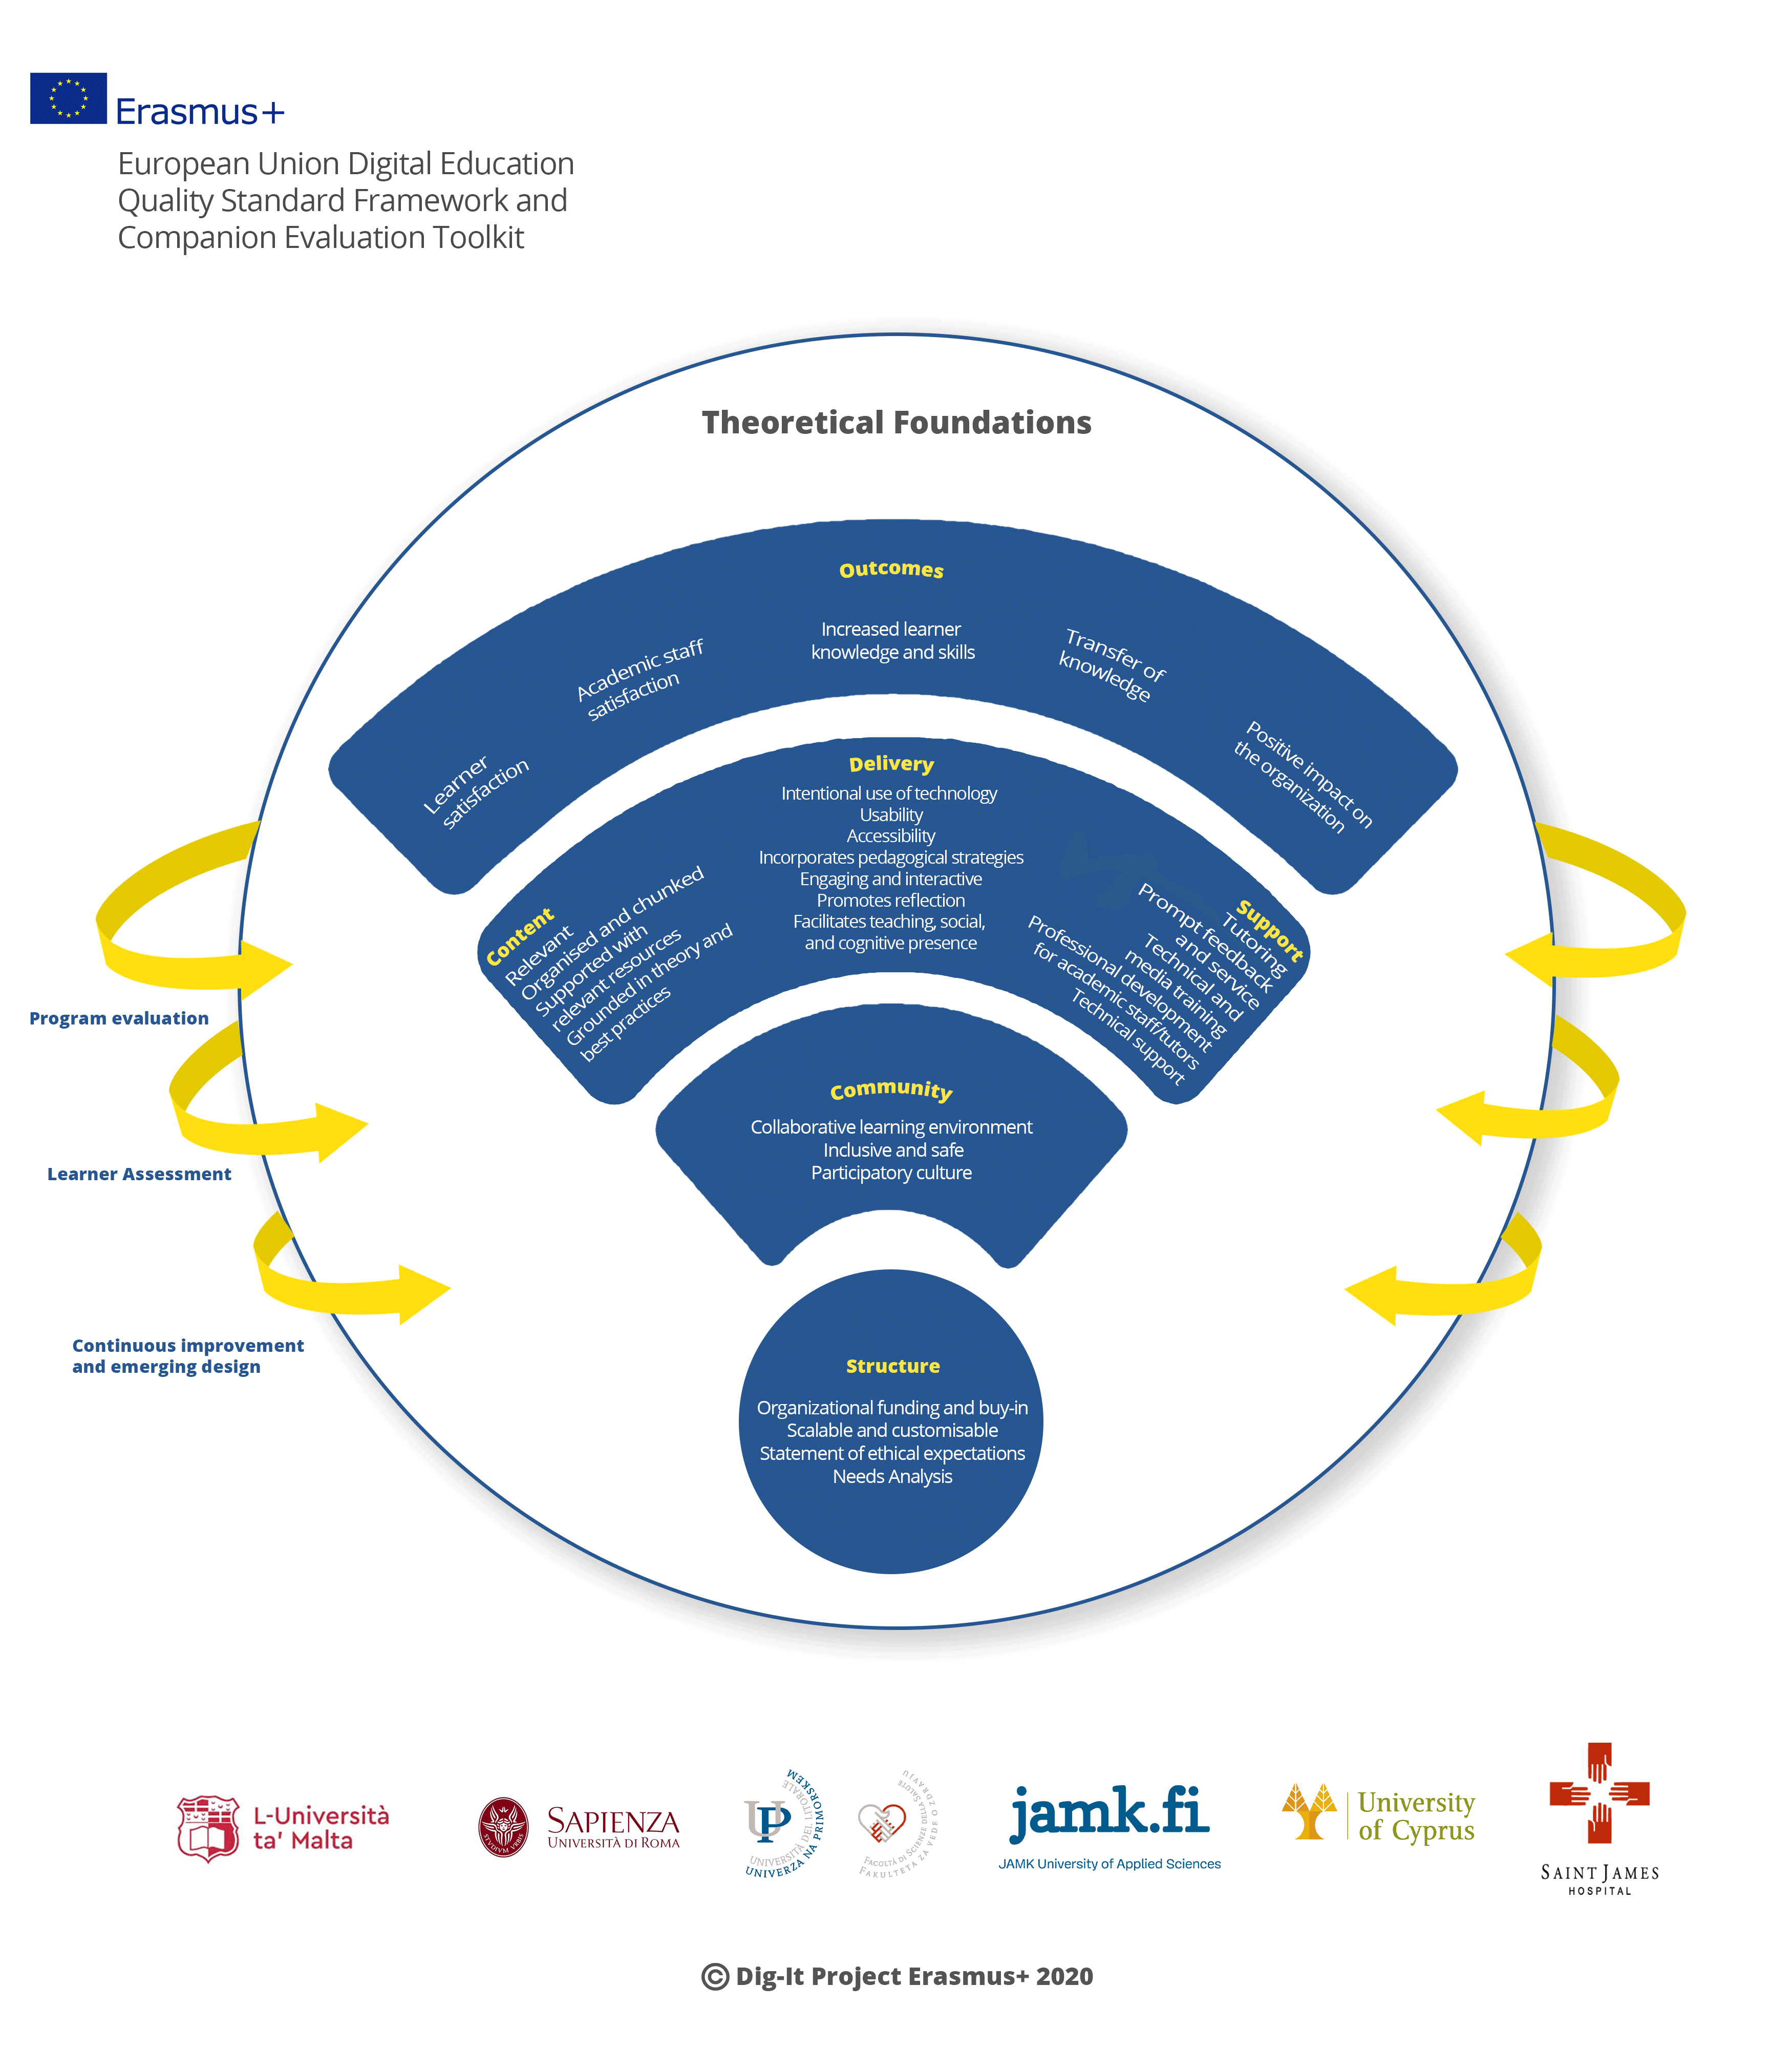
European Union Digital Education
Quality Standard Framework and
Companion Evaluation Toolkit

Slide 22

Step 4 – Companion Evaluation Tool Kit
Companion Evaluation Tool Kit was used ‌to‌ ‌assess‌ ‌programs‌ ‌using‌ ‌
the‌ ‌framework‌.
Temperature‌ ‌Check‌ ‌
Summative‌ ‌Evaluation‌
Interview‌ ‌Protocol‌ ‌
Notes:
Temperature Check brief quantitative Likert scale online survey including two quantitative open-ended questions soliciting information on the EU Digital Education Quality Standard Framework variables (Content, Delivery, Support, Structure, Community, and Outcomes).
Anonymous temperature; approximately 5 minutes to complete.
The purpose is to obtain feedback early in the course so that any minor concerns can be addressed before they become major issues.
Several edits and changes were made by team members before all were satisfied that the temperature check instrument would be effective at collecting data to inform digital educators regarding learner satisfaction with the course and whether changes are required either immediately or in the next course offering. The temperature check instrument is currently being used and data collected so that eventually it can be validated.
‌
brief summative qualitative Likert scale online survey including quantitative open-ended questions also solicits information on the EU Digital Education Quality Standard Framework variables (Content, Delivery, Support, Structure, Community, and Outcomes).
anonymous
10 minutes to complete.
The purpose is to obtain feedback at the end of the course so that any necessary changes and improvements can be made in the next iteration of the course.

Slide 23

Conclusion
The framework:
Resulted from best practices in the literature coupled with the experience of digital education researchers from 5 EU countries participating in an ERASMUS+ project.
Comprises definitions of variables and sub-variables considered essential to effective eLeanring
Proposed as quality standards across the EU and the wider international context.
To be employed in a flexible adaptive manner
Applicable to education and training institutions, industries, and audiences regardless of where they are in the online learning adoption process.

Slide 24
Conclusion (cont.)
Not intended to be a step-by-step guide on how to design, deliver and evaluate online learning
To be used as a quality standard to design effective training that provides a step-by-step support
To be used and employed in a flexible and adaptive manner, and applicable to education and training institutions, industries, and audiences regardless of where they are in the online learning adoption process.
Value of this framework and toolkit are timely when digital education is experiencing an unprecedented boom, and credibility and quality standards are needed.

Slide 26






Thank you for your attention
Logo Plaement Area
If you have any questions, now is the right time to ask!
Contact us on the details below for further info:
IT Services
(+356) 2340 4112/3
/um.itservices
www.um.edu.mt/itservices/help

